Slide 1


Slide 2
Final Project
Online Shoping Management

Slide 3
Introduction
Submitted By :
Faisal Shahzad
Roll # MCE IT 11-25
Supervised By:
Mr. Sohaib Hafeez

Slide 4
Introduction Of OSM
The name of my project is “Online Mobile shopping (OMS)”. This is a website that will provide a facility of online shopping.
In this project there is a beautiful collection of Computers& its accessories of different categories. The users can easily view and select Computers & its accessories of their choice. What's even more useful is the ability to compare items, similar or not, online. You can search through multiple stores at the same time, comparing material quality, sizes and pricing simultaneously. It is a general project & I have selected this project to work out for providing the users better facility of shopping at just one door step. Additionally, unlike a store, online shopping has friendly customer service representatives available 24 hours a day, 7 days a week to assist you with locating, purchasing and shipping your merchandise. All operations are well-organized & offering charming attraction for its customers.

Slide 5
Project goals and objectives
Goals
The main theme of this project is to provide the users an ease of access to the variety of quality of Mobiles & its accessories with so many facilities to accomplish their demands. Now it’s all about just a single click. Here you can take a look of all the items any time in detail with its description available. You don’t have to bind yourself consistently for a long time like in markets instead you are free to visit and order any product any time in a relax environment having your eatables with you at home.

Slide 6
Project goals and objectives
Objectives:
The system will provide a user-friendly environment so that any person having the basic knowledge of Internet may efficiently order the product.
Payment will be done according to the terms and conditions.
It will help in the fast retrieval of data.
Assures the security and safety of data.
It will provide reliable and flexible system.
Provide home delivery and through ATM.
Sell at lower rate due to less over head.
System will focus on speed & accuracy provided during the data processing.

Slide 7
HSM Scope and Reports
Scope of the system
Secure payment processes.
User’s profile system.
Quality products.
Finding current rates online.
Give order online.

Slide 8
Description & Drawbacks of existing system
Description of existing system :-
The system at present working manually ,that
means all the transaction going on within the
system is maintain in a ledger book manually
thus the management needs to transfer the system as a computerized system .

Slide 9
Description of existing system
“Data gathering is a art and a science
1-Information about the Firm
Company policies are guideline that determines the conduct
business.
2-Origin of Information
Financial reports
Personal staff
Professional staff
System documents or manual
3-Information gathering tool
On-site Observation.
Interviews and Questionnaires.

Slide 10
Existing System: Data Analysis
Feasibility Study
Requirement Analysis
Project Planning
Data Analysis

Slide 11
Tool Selection
Selection of the appropriate software is most crucial stage of the development phase. The choice of software tool should be done in keeping view of the problem faced in order to avoid heavy loss of time and money. Tools used for any system development are:
1. Hardware
2. Software

Slide 12
Tool Selection
Hardware:-
For the development and
designing of website we had used better
hardware for better functioning of the
operating system and faster loading of
programs. Hardware required to run this
system will be:
Machine Intel CORE 2
Processor Intel(R) pentrum(R) CPU B950 @ 2.10GHz
RAM 2 GB

Slide 13
Tool Selection
Software:-
Any hardware without software is seemed
to be useless in this environment. So different types of
software are considered for this specific purpose. Chosen
ones are:
Operating System Windows 7/Windows 8
Front end tool HTML, CSS
Back end tool PHP , Java script
Graphic Designing tool Dreamweaver CS6
Database MS SQL
Tools for documentation MS Word

Slide 14
Tools Used for development
Tools and Using Reasons :-
PHP
For making interface and coding.
My SQL
To keep the record of users and
their details also for maintaining User personal data for booking request.
MS Word
For ERD diagram, For Use Case diagram ,System Sequence diagram, Sequence diagram.

Slide 15
Tools Used for development
Tools and Using Reasons :-
CSS
For Style.
Java Script
For handle events and form validation.
Dreamweaver CS6
For making interfaces /front –end and admin panel.
HTML
For front end page management.

Slide 16
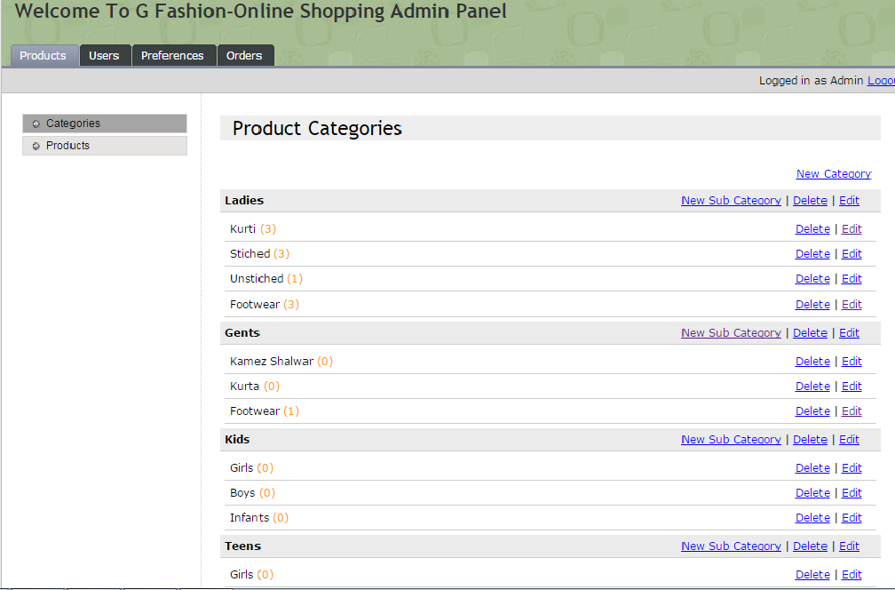
Admin Panel Interface

Slide 17
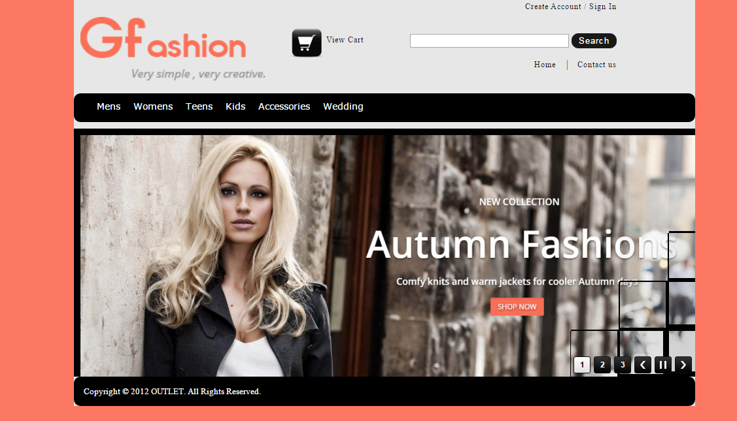
User Interface

Slide 18
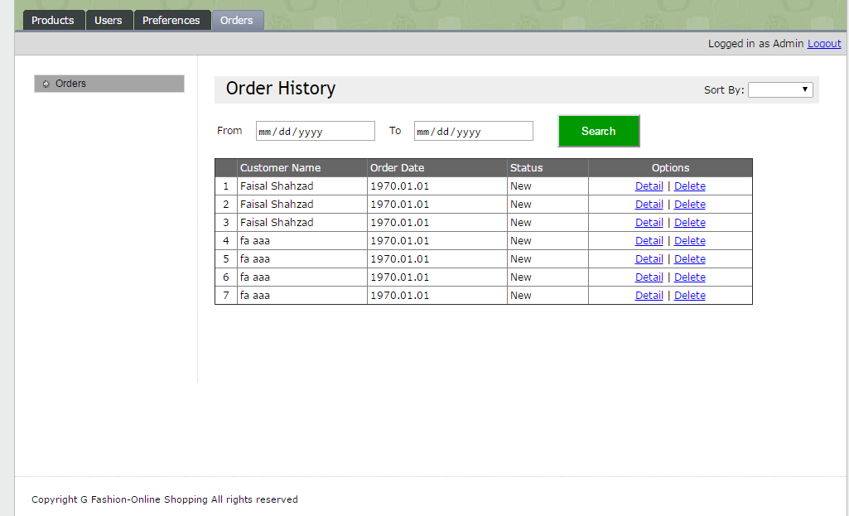
Order Date Base

Slide 19
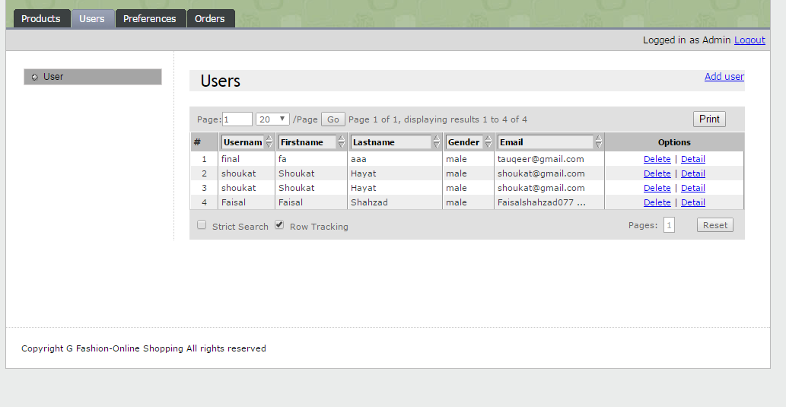
User Date Base

Slide 20


